Slide 1




Plant Disease Prediction
Ranjit Mane
PGA 44
Capstone Project - II

Slide 2

Table of Contents
Sr. No | Content | Slide No.
1. | Introduction | 3
2. | Objective | 4
3 | Data Collection | 5
4 | Data Overview | 6 - 9
5 | Image Preprocessing - I | 10
6 | Random Sampling | 11
7 | Image Preprocessing - II | 12
8 | Model Building Overview | 13
9 | Model Building | 14 - 17
10 | Model Testing | 18
11 | Model Deployment | 19 - 20
15 | Future Scope | 21
16 | Conclusion | 22

Slide 3
Introduction
Agriculture, the world's largest industry, employs over one billion people and contributes more than $1.3 trillion to global food production annually. This sector is vital to economic growth, constituting 4% of the global gross domestic product (GDP).
However, the industry faces significant challenges, with an estimated $220 billion USD in worldwide crop losses each year attributed to plant diseases caused by biotic organisms like fungi, bacteria, viruses, and abiotic factors such as environmental conditions.
Early detection of plant diseases is very crucial task, as it enables farmers to take preventative action, stopping the disease's transmission to other plant sections. Farmers and plant pathologists have traditionally depended on physical examination to diagnose illnesses and form opinions founded on their prior knowledge.
The physical examination of plant diseases produces low accuracy, requires a lot of time, and could not accurately anticipate the plant disease. Creating an automated method capable of accurately classifying to deal with these issues is vital.
Notes:
According to Food and Agriculture Organization

Slide 4

Objective
The main objective of this project is to develop an effective plant disease detection system using advanced technologies like deep learning and transfer learning. By doing so, we aim to contribute to the improvement of crop yield and sustainable agriculture practices.

Slide 5
Data Collection
Data was collected from Plant Village Dataset from GitHub.
Originally, this dataset consists of about 87K RGB images of healthy and diseased crop leaves which is categorized into 38 different classes.
From this huge dataset, I have collected only images of Apple, Strawberry and Grape leaves for model building purpose.
Details of images are as follows,
Plant | No of Images
Apple | 3171
Strawberry | 1565
Grape | 2695

Slide 6
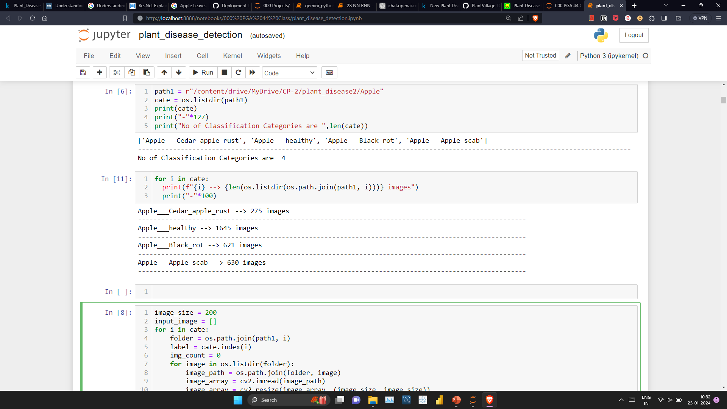
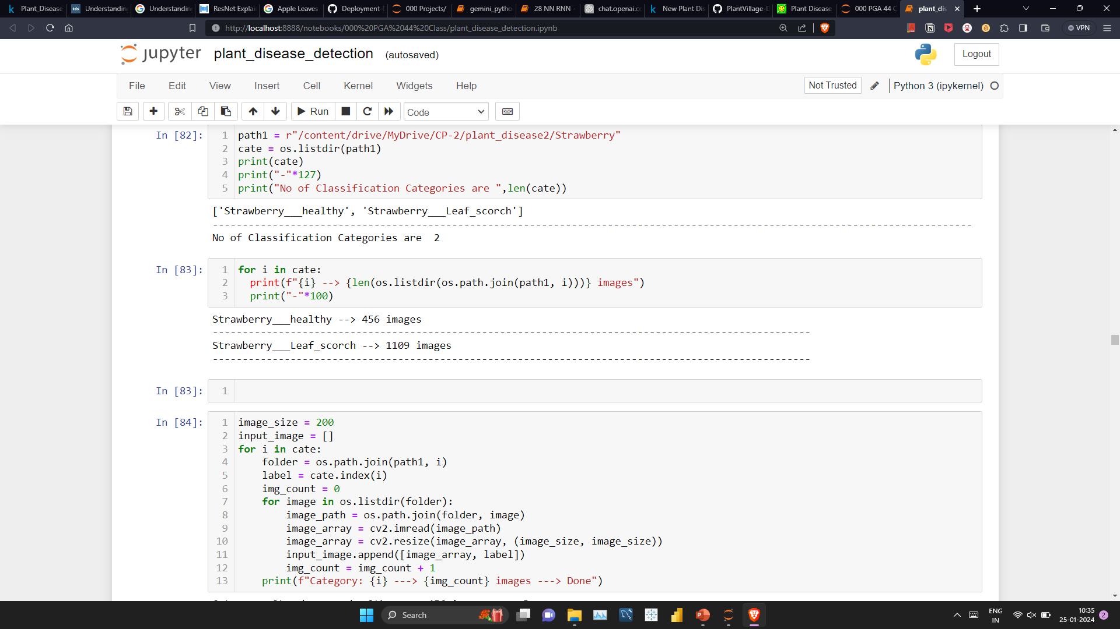
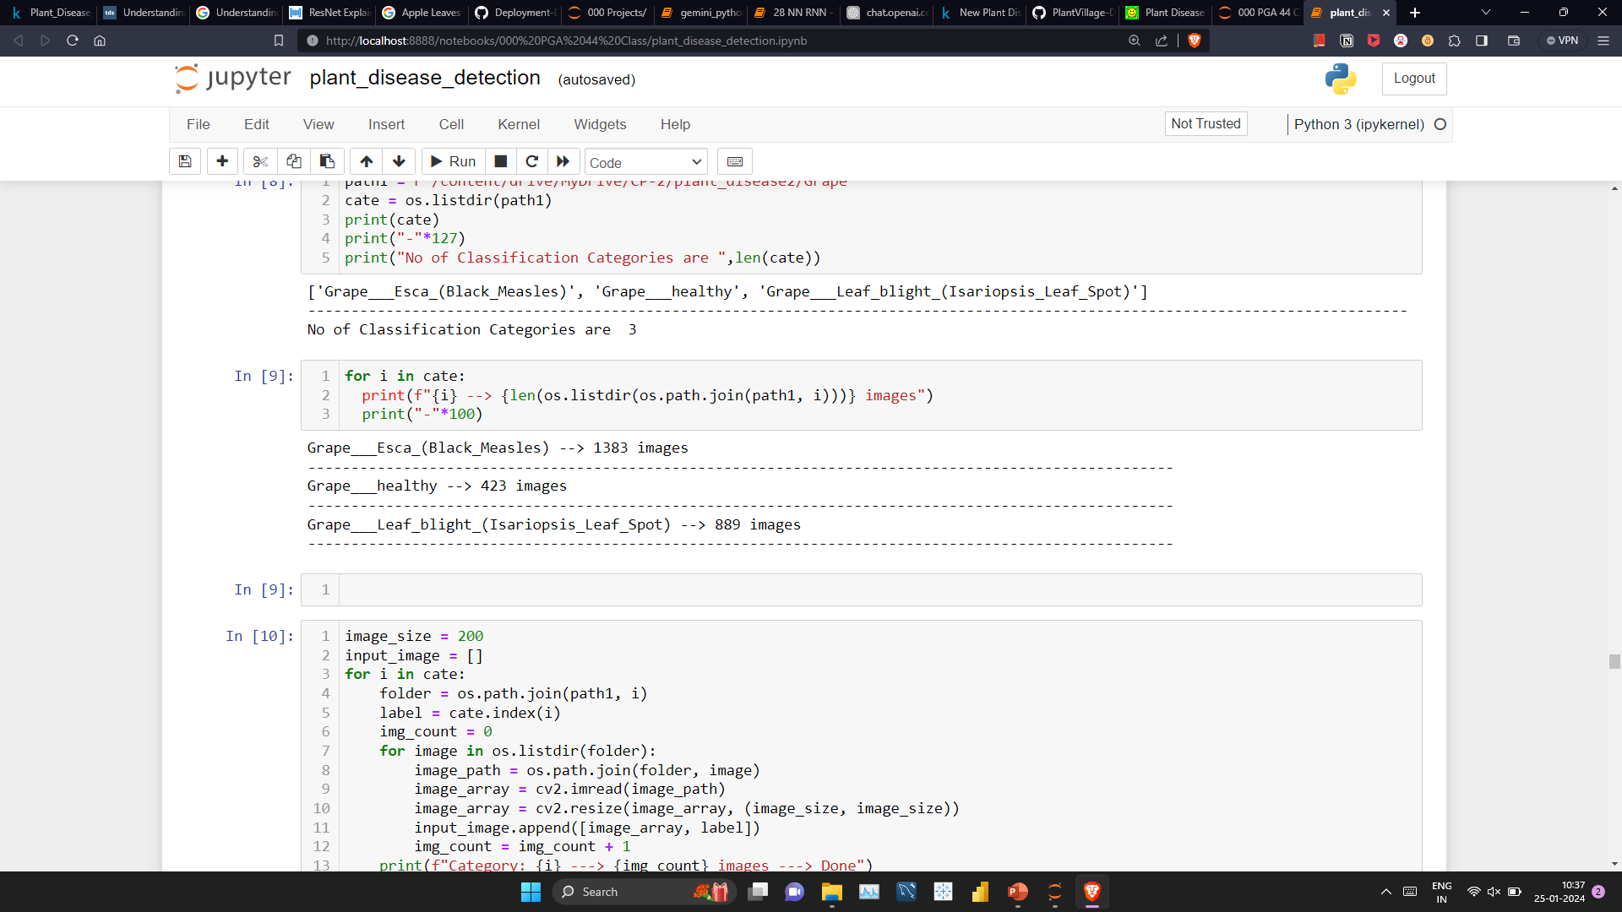
Dataset Overview - I
Representation of each category in dataset is as follows,
Apple leaves:
Strawberry leaves:
Grape leaves:

Slide 7
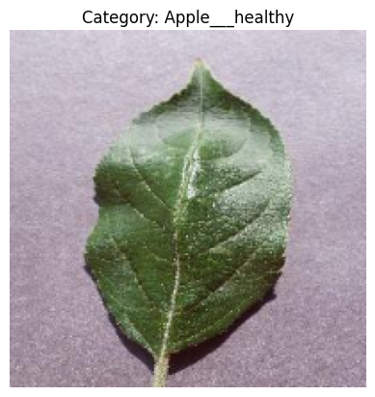
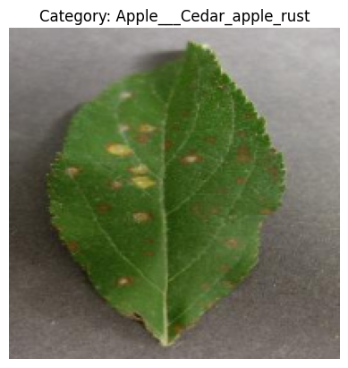
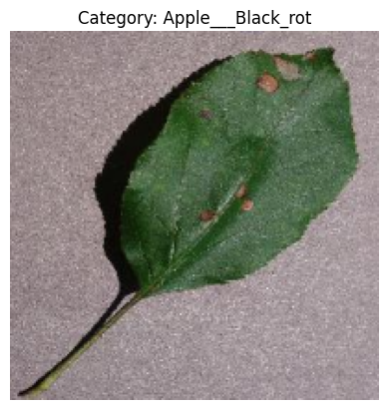
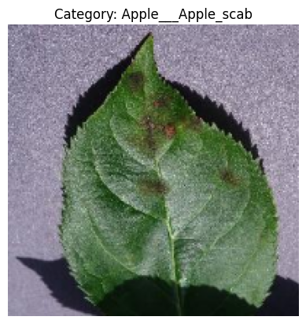
Dataset Overview - II

Slide 8
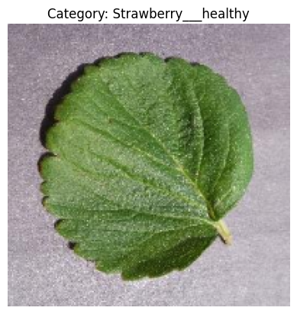
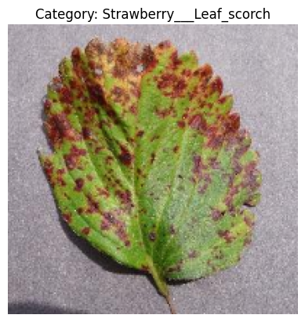
Dataset Overview - III

Slide 9
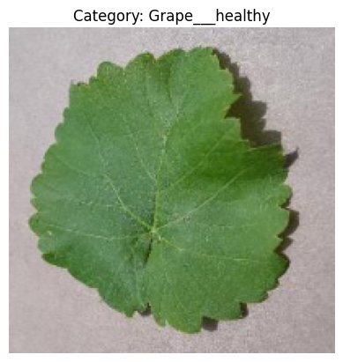
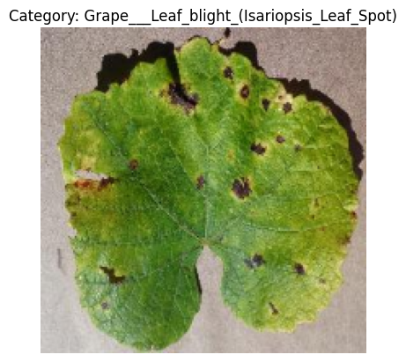
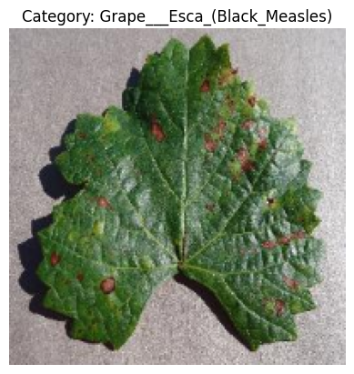
Dataset Overview - IV

Slide 10
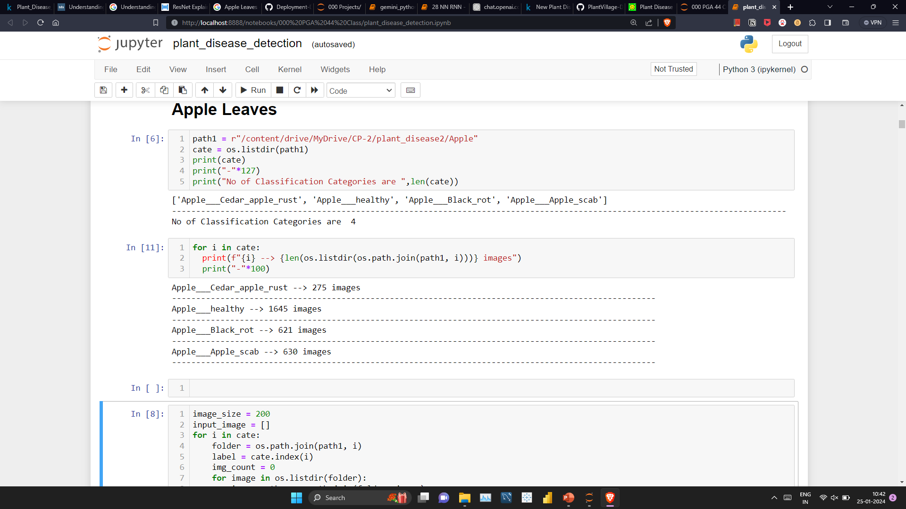
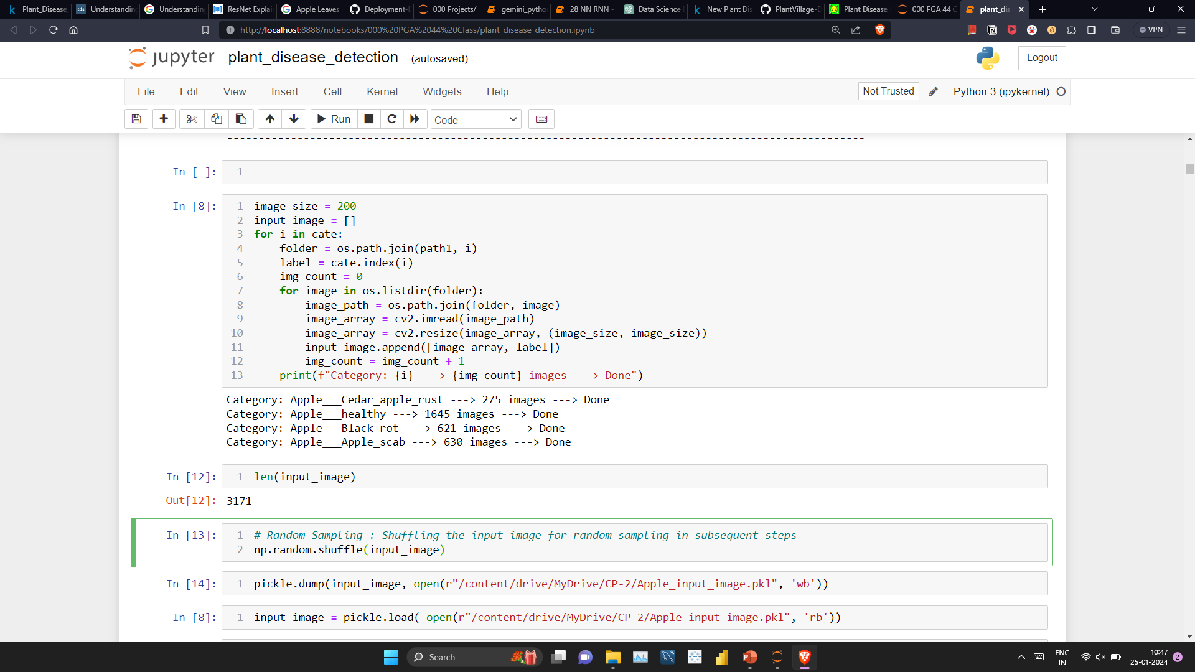
Image Preprocessing-I

Slide 11
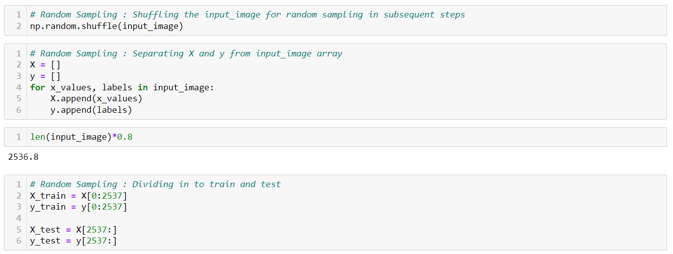
Random Sampling

Slide 12
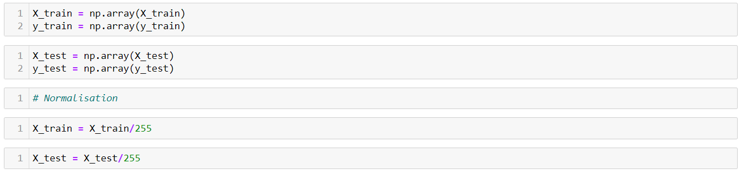
Image Preprocessing-II

Slide 13
Model Building Overview
Plant Disease Detector
Apple Leaves
Strawberry Leaves
Grape Leaves
CNN Model
CNN Model
VGG16 Model
Xception Model
Resnet50 Model
Resnet50 Model
Xception Model
VGG16 Model

Slide 14
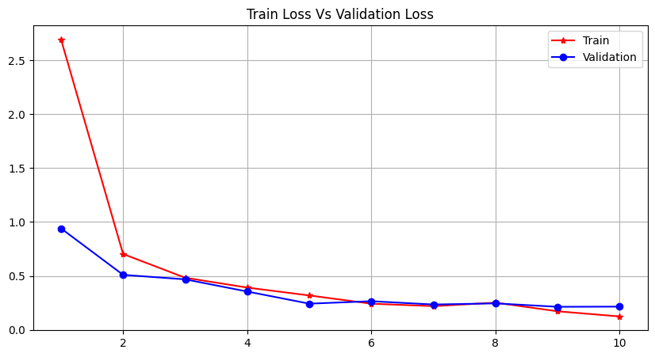
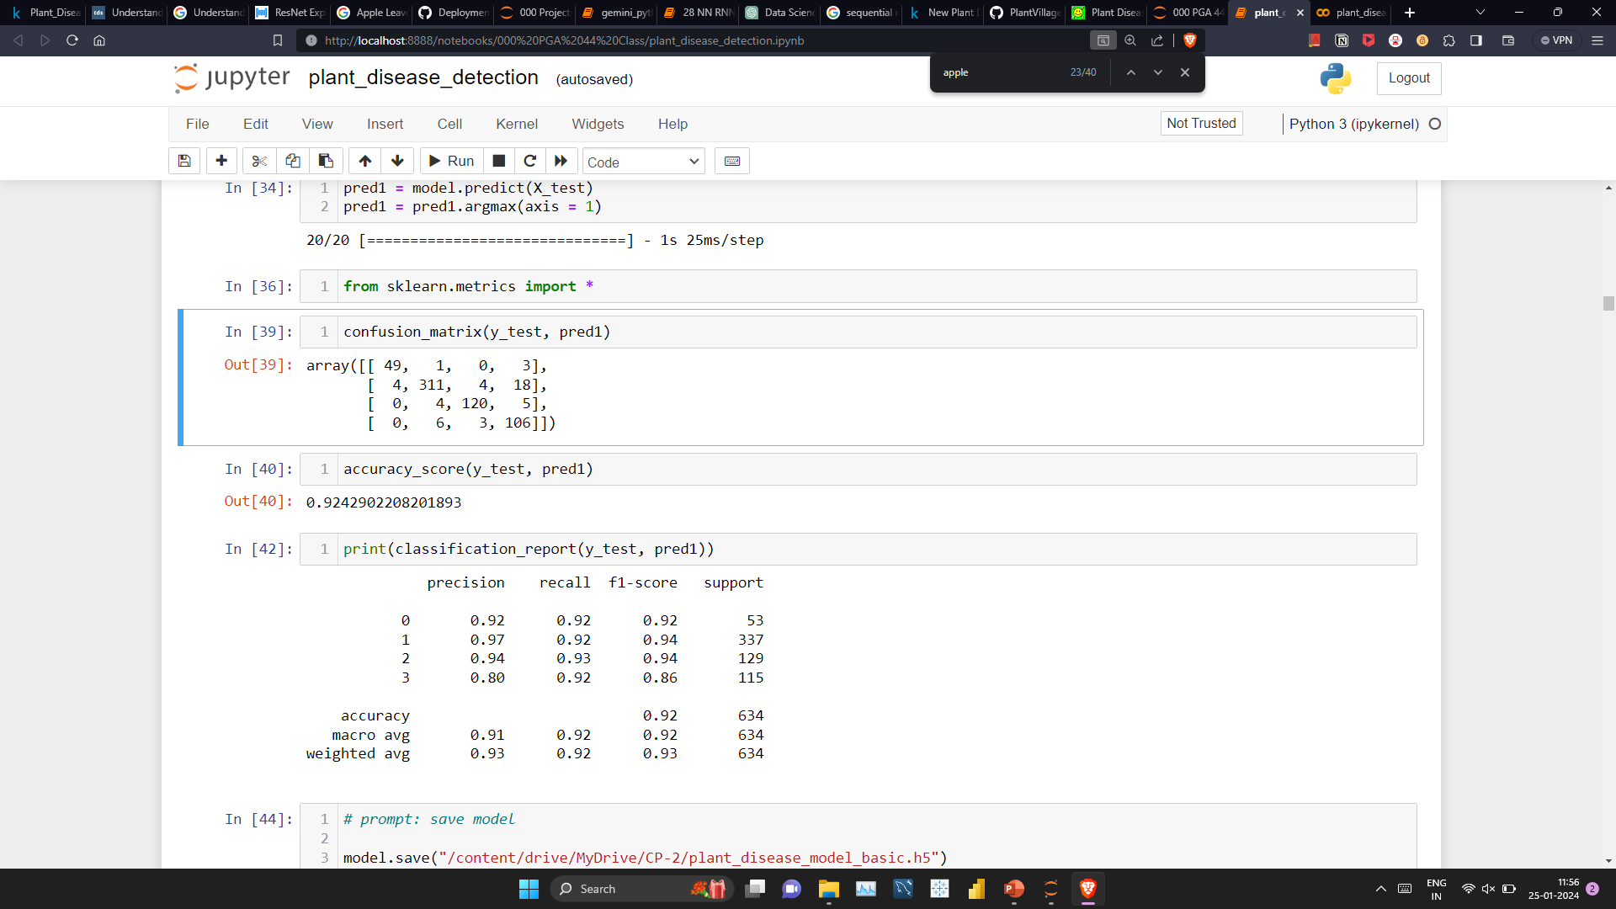
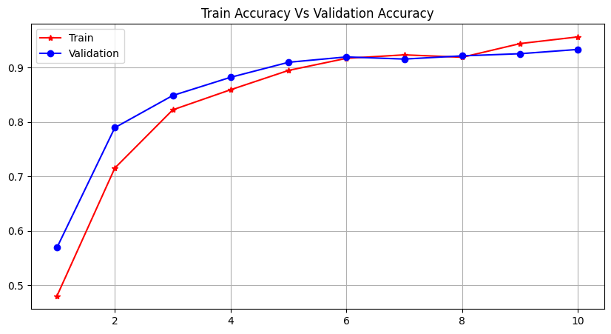
Model Building – CNN (Apple)
Built Model with 8 epochs

Slide 15
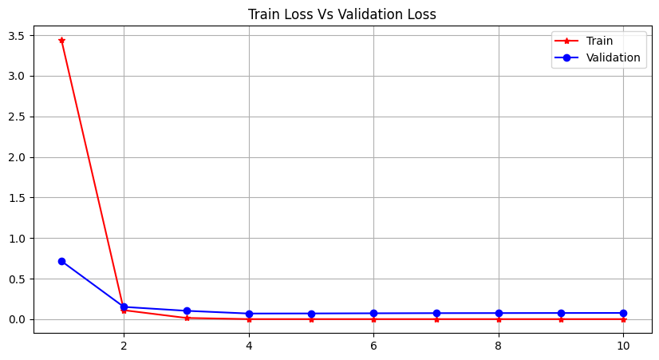
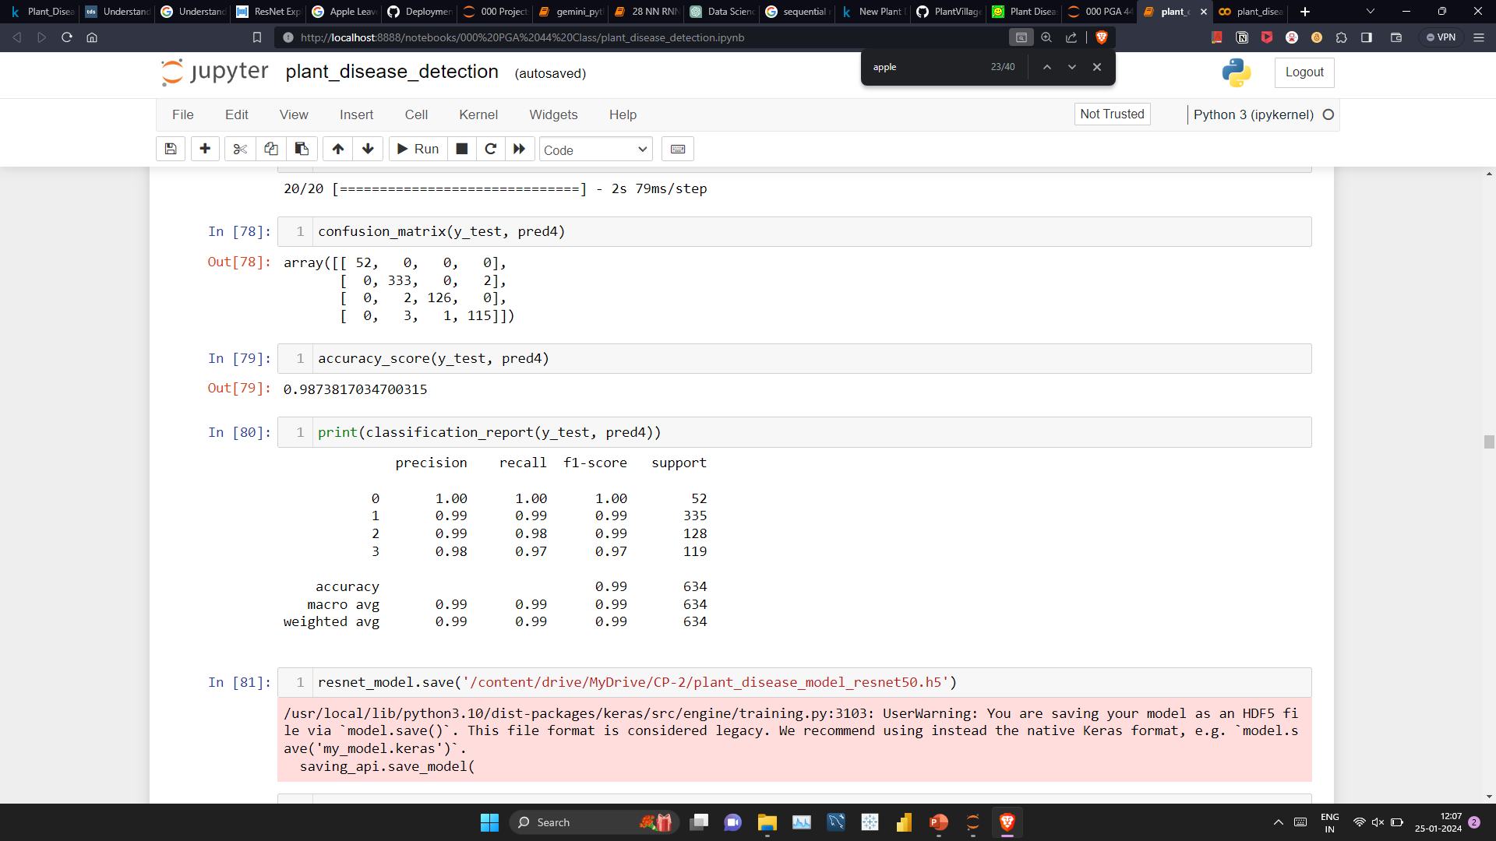
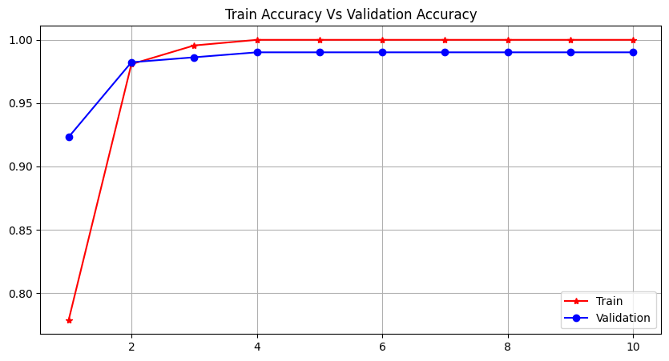
Model Building – Resnet50 (Apple)
Built Model with 4 epochs

Slide 16
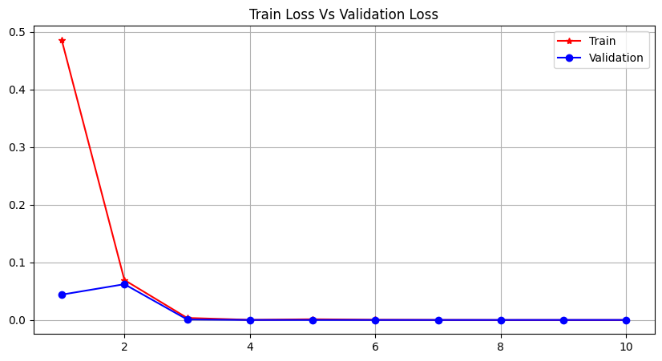
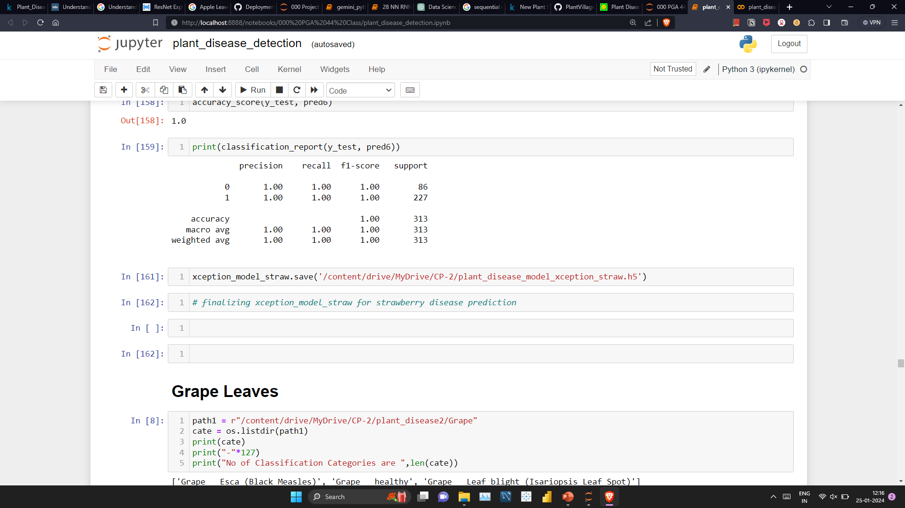
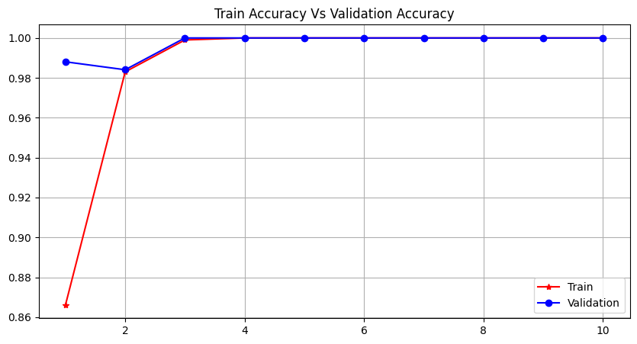
Model Building – Xception (Strawberry)
Built Model with 10 epochs

Slide 17
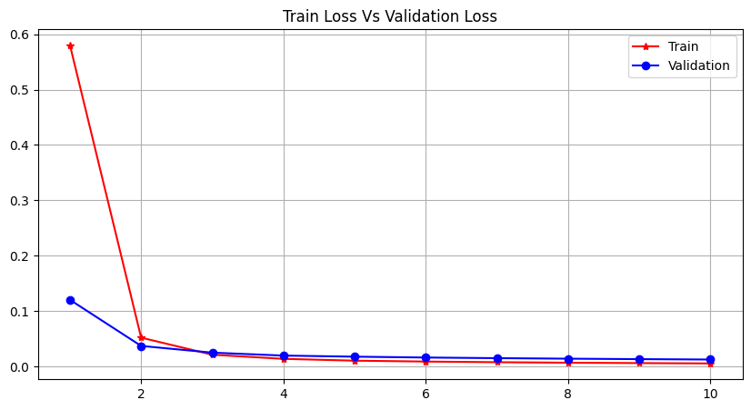
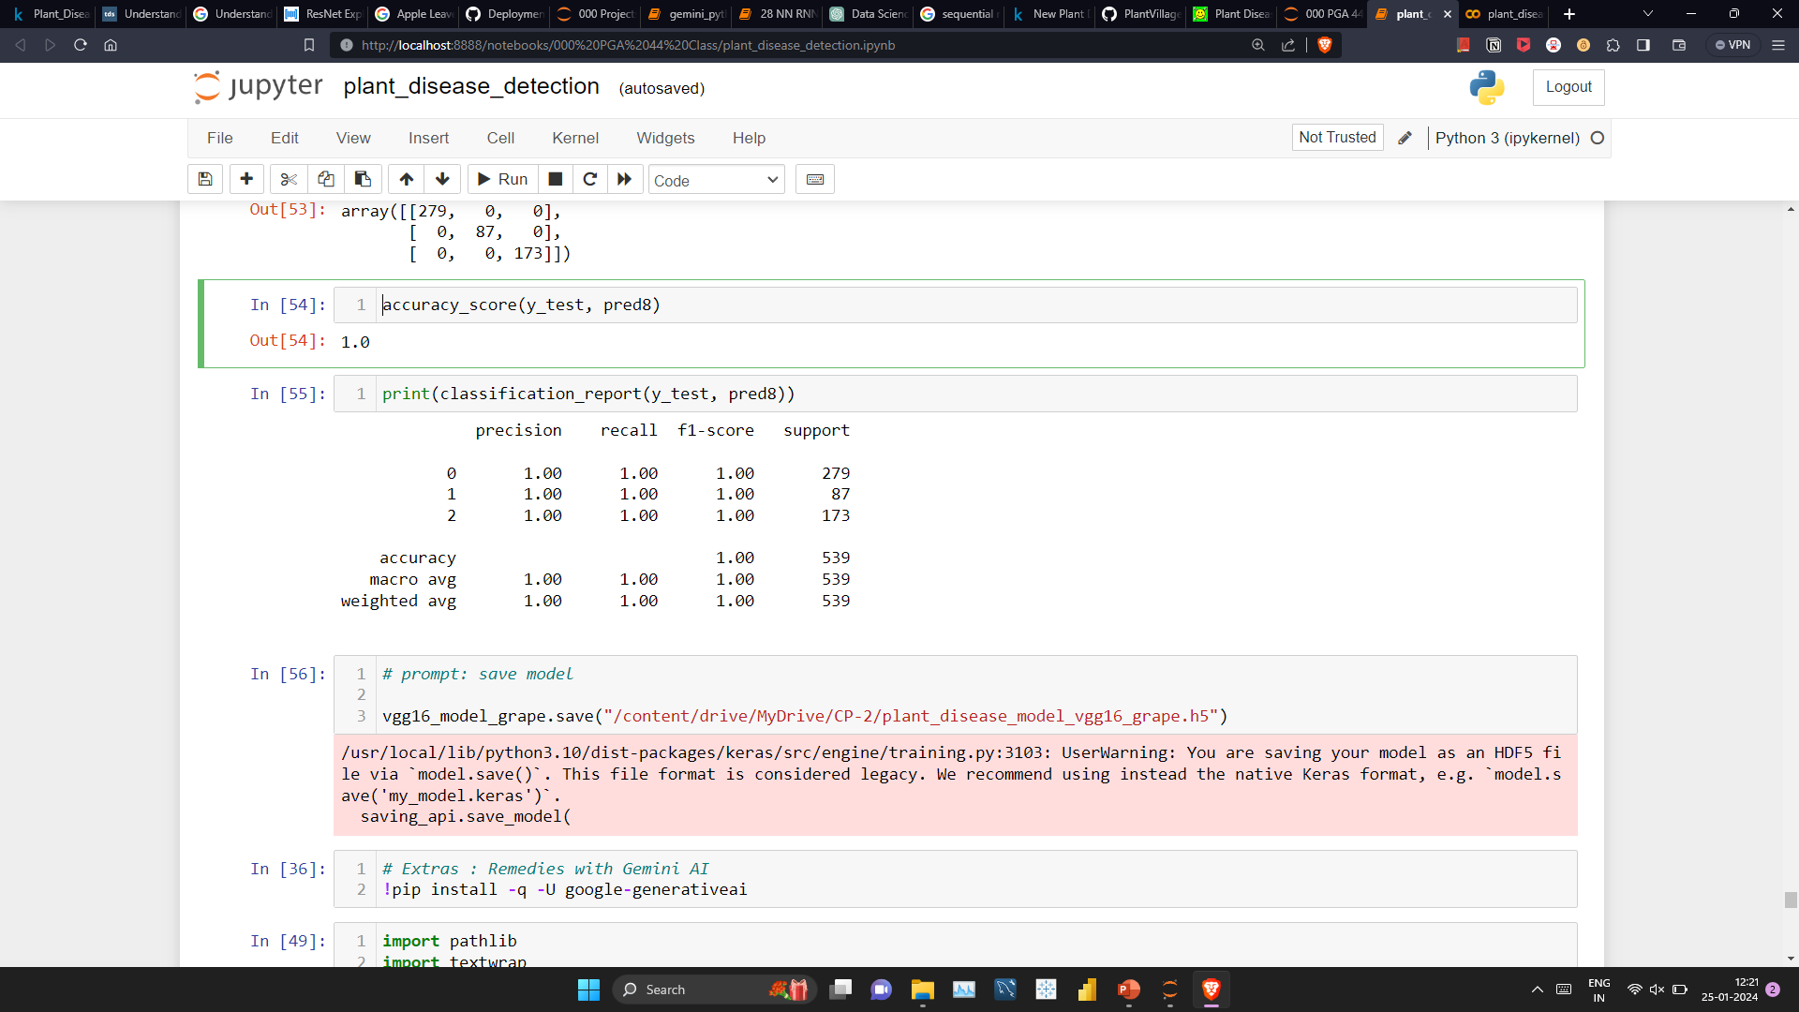
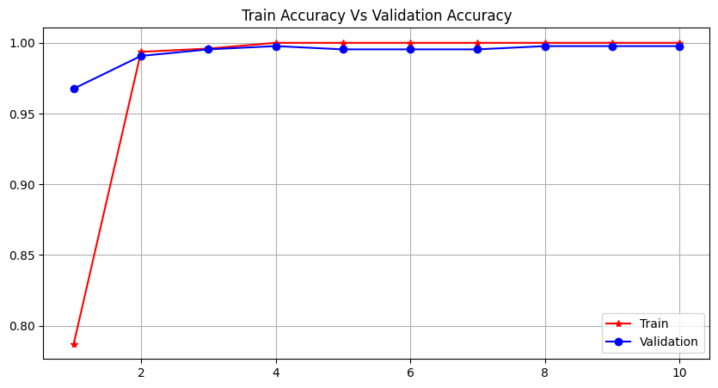
Model Building – VGG16 (Grape)
Built Model with 10 epochs

Slide 18
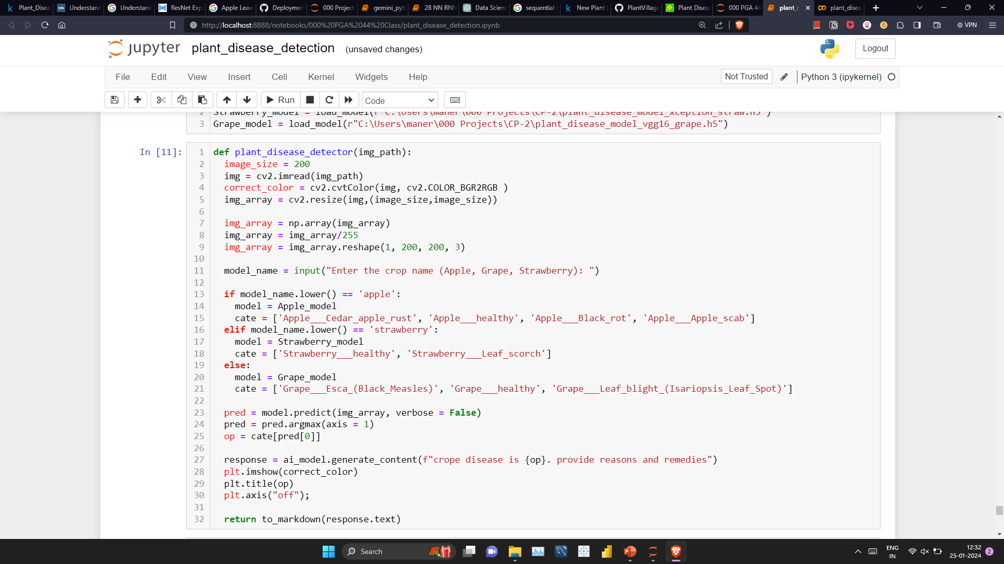
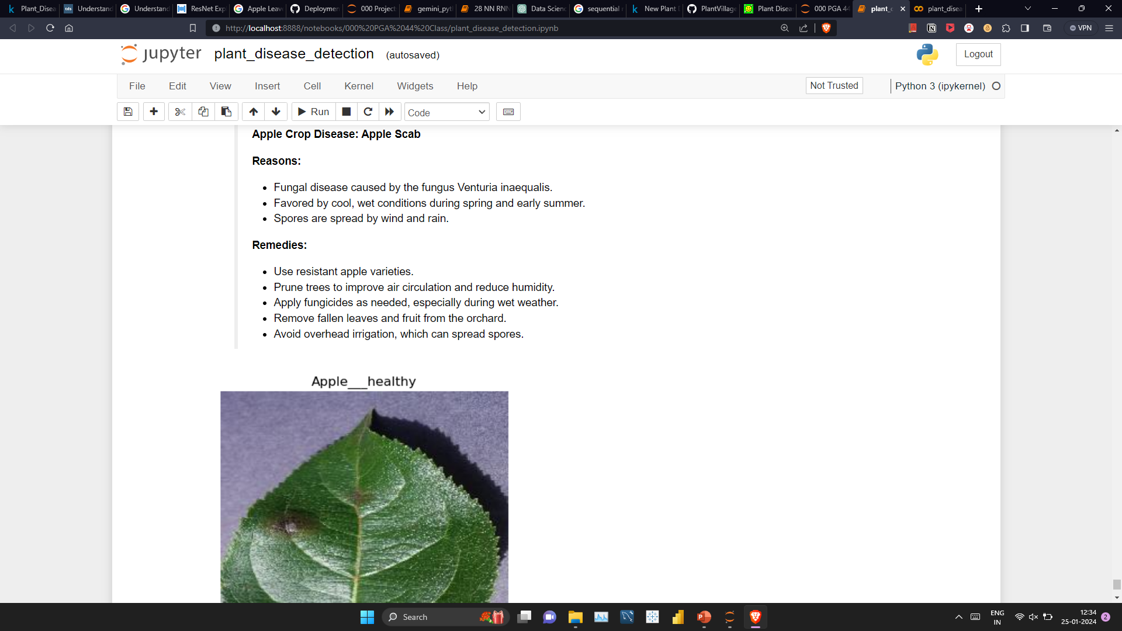
Model Testing (def)

Slide 19
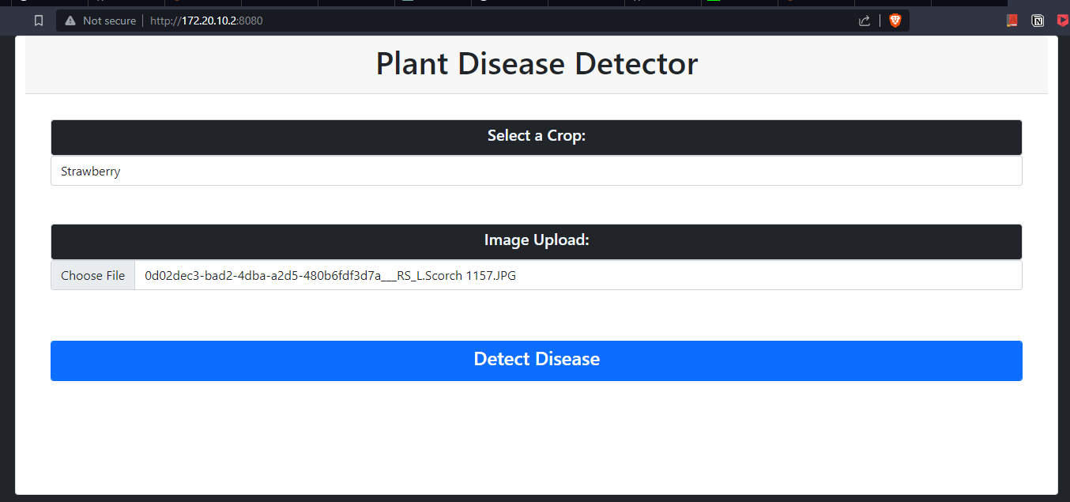
Model Deployment - I

Slide 20
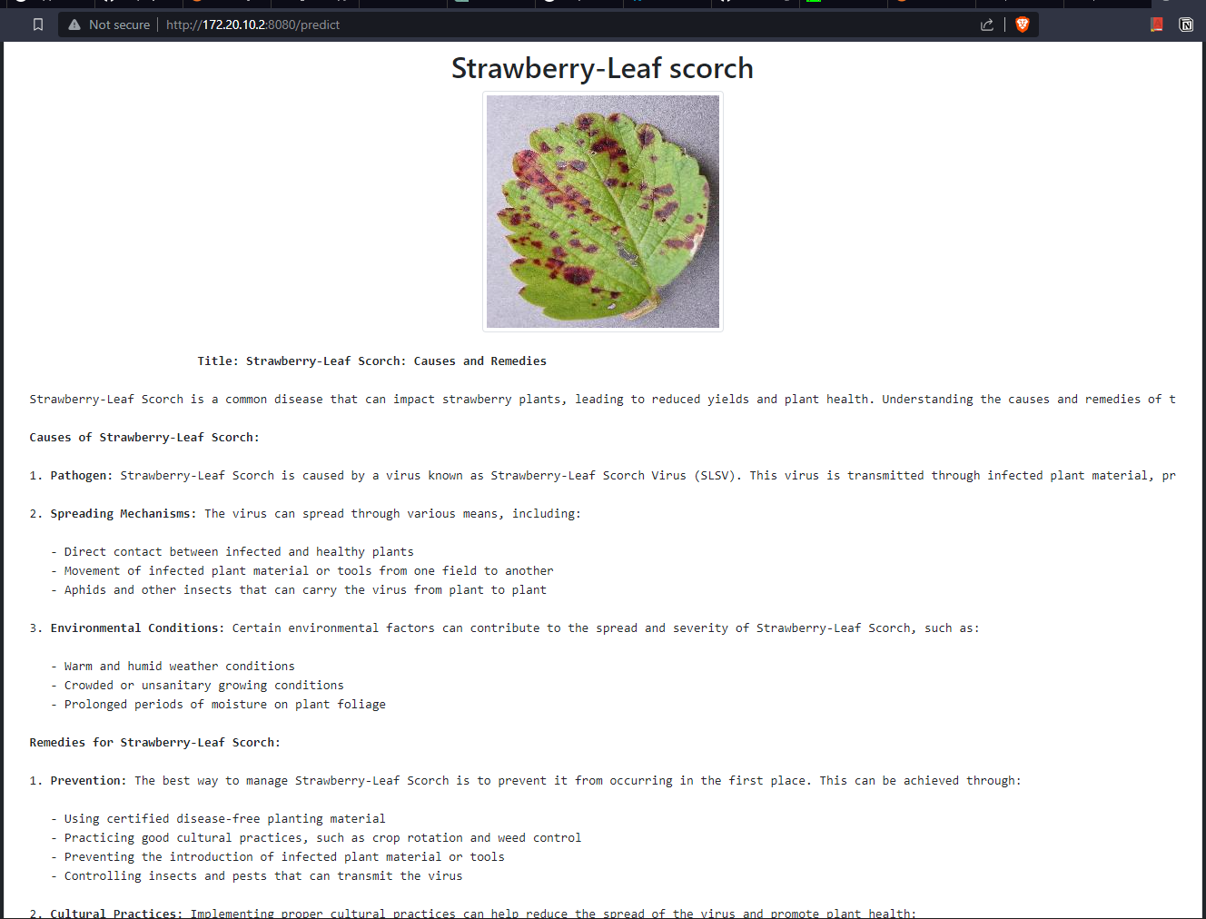
Model Deployment - II

Slide 21
Future Scope
Looking ahead, there are exciting possibilities for the future of this project. We envision expanding our dataset, integrating real-time data for more dynamic detection, and exploring emerging technologies that could further enhance the applicability of our model.
Incorporating advanced sensors and Internet of Things (IoT) devices into the agricultural environment for real-time monitoring of plant health. This could provide continuous data streams for more accurate and timely disease detection.

Slide 22
Conclusion
In conclusion, Project represents a significant step forward in addressing the challenges of plant diseases in agriculture. By leveraging deep learning and transfer learning, we've laid the foundation for a robust and scalable solution.

Slide 23
Thank You

